Slide 1

Chris Follows & John Jackson
University of the arts London
ALT-C 2012
14 September 2012

Slide 2
Digital Integration into Arts Learning (DIAL) project
Partially funded by JISC.
Two year project, year one completed.
DIAL project aims to improve graduate employability and develop confidence and capability in the adoption and integration of digitally enhanced learning for staff and students.

Slide 3
“You make me feel physically sick when I hear you talk……about using ‘digital”
Course Director UAL academic leaders forum 2012

Slide 4
DIAL small projects
Self identified
Time to develop
Grassroots
Problem based
Interest based
Open content communities (Culture of helping each other)

Slide 5
Early thoughts and common features from DIAL evaluation of pilot projects:
The DIAL projects provide opportunity for personal reflections on personal roles and emerge from long-standing challenges people want to tackle, and perhaps up to now have not had the time or resources to attend to them:
Teachers’ fear of learning in public. (Online reflective practice)
Dealing with the discomfort of making curricular resources public. (Open educational resources, OER)
Anxieties relating to presenting oneself online. (Professional open/online identities)

Slide 6
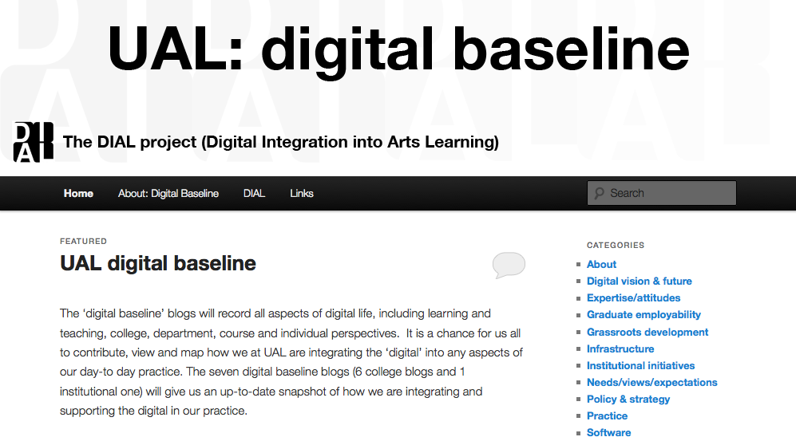
The ‘digital baseline’ blogs http://ualdigitalbaseline.myblog.arts.ac.uk/

Slide 7
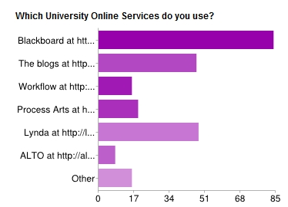
DIAL Surveys
Your Digital World - please tell us more!

Slide 8
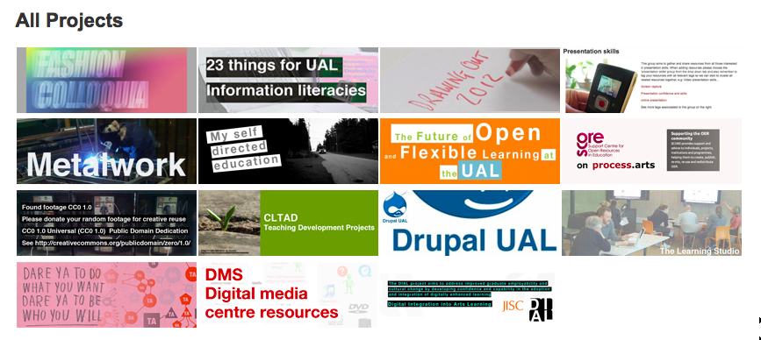
Open online specialist groups

Slide 9
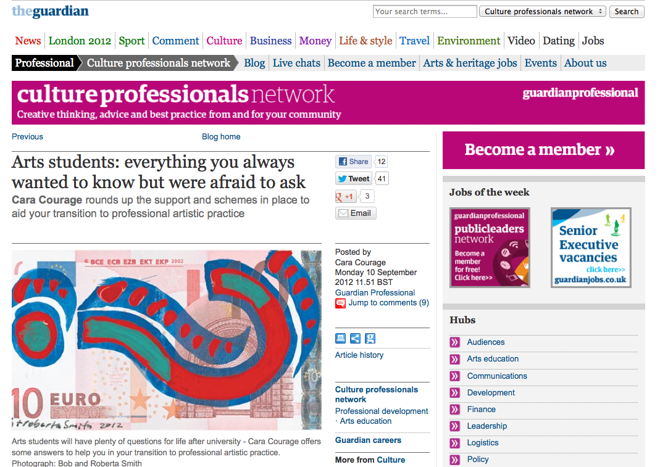
Support cross department/project collaboration
http://www.guardian.co.uk/culture-professionals-network/culture-professionals-blog

Slide 10

Thank you
Chris Follows and John Jackson
University of the Arts London
272 High Holborn
London
WC1V 7EY
Email: c.follows@arts.ac.uk & j.d.jackson@arts.ac.uk
Profile: http://process.arts.ac.uk/users/cfollows

