Slide 1
Chris Follows process.arts.ac.uk DIAL & SCORE Del 2012 5 September 2012

Slide 2
“You make me feel physically sick when I hear you talk…”
UAL academic leaders forum 2012

Slide 3
“You make me feel physically sick when I hear you talk… …about using ‘digital”
UAL academic leaders forum 2012

Slide 4
Common words & concerns student engagement in digital literacies = same as staff?
UAL academic leaders forum 2012

Slide 5
Open Education in Practice. Hard and soft skills for creating open educational resources (OERs) and open content communities process.arts.ac.uk DIAL & SCORE

Slide 6
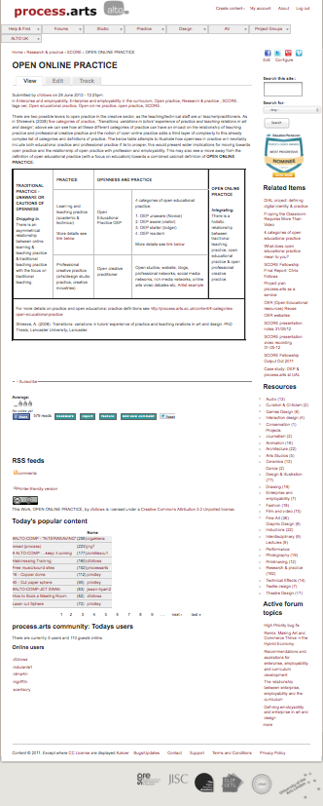
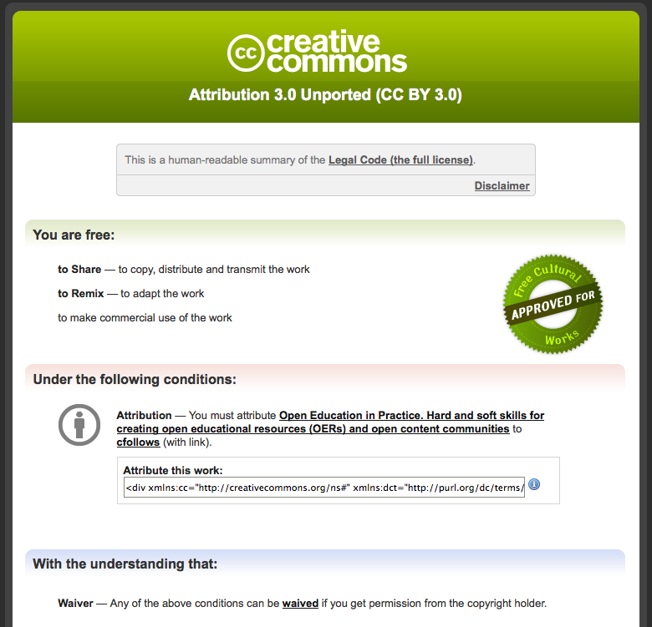

Slide 7
Open Education in Practice. Hard and soft skills for creating open educational resources (OERs) and open content communities process.arts.ac.uk DIAL & SCORE

Slide 9
http://process.arts.ac.uk/
Open resource for sharing practice/knowledge and creating OERs.
Not course aligned, alternative VLE environment that encourages and supports rich media experimentation and informal learning.
Non-commercial but sector driven/owned.
Grass roots, innovation & agile development.
Open to everyone, staff & students: Global and local
Straddles the institution/educational (formal learning) environment and the social (informal learning) environment.
Experimental’ space for open educational practitioners.
Defining a new language for open edu-social practice without conforming or being influenced by pre-existing academic structures and processes.
Informal learning.

Slide 10
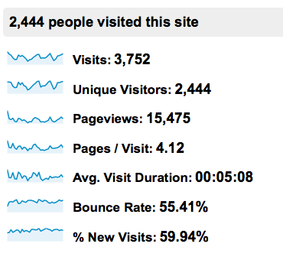
Participation May 2012
AVERAGE PER MONTH:
4k visitors a month.
2-3k unique visitors a month.
Below Analytics May 2012:
Logged in users = 362
All content posts = 1450.
Video direct = 195.
3rd Party video posts = 150.
Image/text/audio = 950.
Forum topics = 105.
Conversation:
Comments = 470.
Tags = Thousands.

Slide 11
Open Education in Practice. Hard and soft skills for creating open educational resources (OERs) and open content communities process.arts.ac.uk DIAL & SCORE

Slide 12
Digital Integration into Arts Learning (DIAL) project
Partially funded by JISC.
Two year project of which 9 months have been completed.
DIAL project aims to improve graduate employability and develop confidence and capability in the adoption and integration of digitally enhanced learning for staff and students.

Slide 13
Early thoughts and common features from DIAL evaluation of pilot projects:
The DIAL projects provide opportunity for personal reflections on personal roles and emerge from long-standing challenges people want to tackle, and perhaps up to now have not had the time or resources to attend to them. Some common OEP related aspects being addressed by DIAL:
Teachers’ fear of learning in public. (Online reflective practice)
Dealing with the discomfort of making curricular resources public. (Open educational resources, OER)
Anxieties relating to presenting oneself in video and online. (Professional open/online identities)

Slide 14
The ‘digital baseline’ blogs will record all aspects of digital life, including learning & teaching, college, department, course & individual perspectives http://ualdigitalbaseline.myblog.arts.ac.uk/

Slide 15
Surveys Your Digital World - please tell us more!

Slide 16
http://www.metro.co.uk/tech/908698-facebook-sets-out-plans-to-put-adverts-in-users-newsfeeds

Slide 17
Connectivity is king
‘Content is not king’ (Andrew Odlyzko’s)
‘Despite the rhetoric of the content industry, the most valuable contribution to our economy comes from connectivity, not content. Content is the ginger in gingerbread—important, no doubt, but nothing like the most valuable component in the mix.’ (Remix: Making Art and Commerce Thrive in the Hybrid Economy. Lawrence Lessig)

Slide 18
Handling OER Rich media

Slide 20
Open Education in Practice. Hard and soft skills for creating open educational resources (OERs) and open content communities process.arts.ac.uk DIAL & SCORE

Slide 21
Shreeve, A. (2008). Transitions: variations in tutors' experience of practice and teaching relations in art and design. PhD Thesis, Lancaster University, Lancaster): Shreeve’s 5 Categories of practice. Relationships between professional practice and teaching practice.

Slide 22
Lodger
Visitor
Novice

Slide 23
OPEN ONLINE PRACTICE

Slide 25
Where do you live/practice online?

Slide 26
Open Education in Practice. Hard and soft skills for creating open educational resources (OERs) and open content communities process.arts.ac.uk DIAL & SCORE

Slide 27
Finding resources, support and clustering content Question: Which digital skill sets are important to you Knowing where to search. Because there can be all this stuff out there but if you don’t know where to look… there should be resources to teach others how to narrow things down. Knowing where to look and how. We should be told more about resources available, more advertising done for them. Knowing how to search for information. There should be a search engine in the VLE to make it easier to find things. Searching online for the right thing.

Slide 28
Hard and soft skills for creating OERs

Slide 29
Soft skills for creating OERs & OEP communities
Digital Citizenship
Guidance
Global and local networks/communities
Respectful & open aware (content use & IPR)
Open practice mentor
Monitoring and supervision
Acknowledgment (is someone out there)
Stewardship

Slide 30
DIAL groups will include the combined experience levels of staff & students and acknowledge that each DIAL participant may be a novice and expert at the same time in these new digital domains Engage and support maximum stakeholder participation and communication between DIAL project communities of practice, including open debate/forum (live & online), cross college/alumni/industry interaction, course/staff/student level case studies, events, workshops and online resources.

Slide 31
Motivation to participate

Slide 32
How do we encourage use, reuse, open practice, debate & comment?

Slide 33
Voluntary openness (Difficult) What are the rewards? or Compulsory openness (Easy)? What are the rewards? Compulsory part of the assessment

Slide 34
Open Education in Practice. Hard and soft skills for creating open educational resources (OERs) and open content communities process.arts.ac.uk DIAL & SCORE

Slide 35
The specialist group sections have continued to develop and we now have 15 active groups. Once a community can commit and want to take 'ownership' of a specialist section we have develop this requirement appropriately.

Slide 36
Thank you
Chris Follows
Email: c.follows@arts.ac.uk
University of the Arts London 272 High Holborn London WC1V 7EY Mobile: 07703 887845

